Slide 1

CHILD RESCUE & REHABILITATION
Abhishek Bagdare, Viraj Shah & Dhaval Patel

Slide 2
PROBLEM STATEMENT
According to data from Census 2011, the number of child laborers in India is 10.1 million of which 5.6 million are boys and 4.5 million are girls
3 out of Every 7 Children face some form of abuse during their childhood
Many orphans are taken hostages as child labors, No resources or system to fight or rescue and rehabilitate them.
NGOs do not have a centralized system that can help interact with multiple parties to rescue and rehabilitate children who are victims of multiple atrocities.

Slide 3
APPROACH
Design a software system for NGOs that can initiate a restoration process for a child who has been a victim of atrocities through reporting to NGO
A Volunteer from NGO would be assigned to the case, he would then examine the case and redirect the case to the necessary stakeholder.
Children who faced physical abuse would be sent to doctors, mental abuse would be sent to counsellor or psychiatrist depending on their state of need. Incase of any unlawful situation, the case can be sent to a lawyer.
After his treatment , the child would be sent to a rehabilitation home where his safety would be safeguarded.

Slide 4
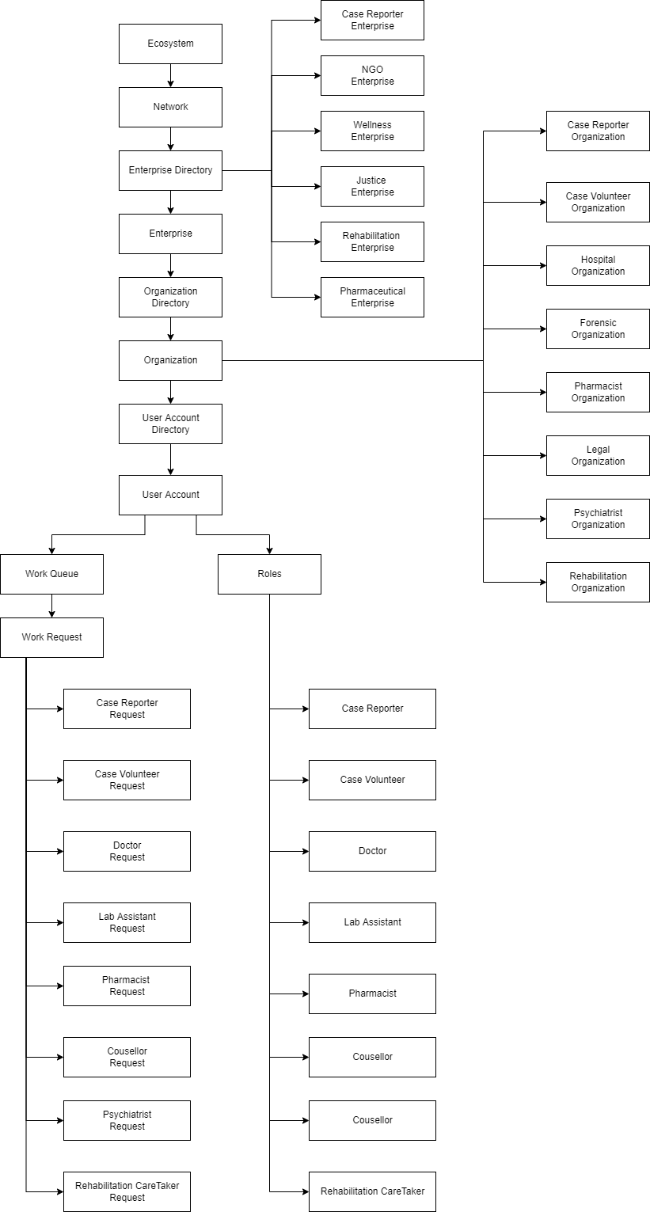
OBJECT MODEL

Slide 5
ENTERPRISES
System Admin : Manages the entire System, Adds Networks, Enterprises and Logins
NGO : Contains Organizations that can provide Initial response support to the child
Justice : Contains Organizations that can provide Legal support to the child
Wellness: Contains Organizations that can provide Hospital support to the child
Rehabilitation : Contains Organizations that can provide Rehab to the child

Slide 6
USE CASES (WORK REQUESTS)
Use Case 1: Case Reporter - Case Volunteer Work Request
Case Reporter registers a report with all the details regarding the assault.
The request is sent to the Case Volunteer who accepts and assigns the case to concerned entities for further proceedings
Use Case 2: Case Volunteer - Doctor Work Request
Case Volunteer reads the report regarding the assault and request is sent to Doctor.
The Doctor accepts a case and sends invite to the patient for appointment

Slide 7
USE CASES (WORK REQUESTS)
Use Case 3: Doctor – Lab Assistant Work Request
Doctor reads the report regarding the assault and request is sent to Lab Assistant for conducting the Lab Tests.
The Lab Assistant accepts a lab test requests and sends results to the doctor
Use Case 4: Doctor - Pharmacy Work Request
Doctor sends the request to Pharmacist after the health check-up.
The Pharmacists views the prescription request and sends invite to patient for pickup
The Doctor can then view the results.

Slide 8
USE CASES (WORK REQUESTS)
Use Case 5: Case Volunteer – Counsellor Work Request
Case Volunteer reads the report regarding the assault and request is sent to Counsellor.
Use Case 6: Case Volunteer – Lawyer Work Request
Case Volunteer reads the report regarding the assault and request is sent to Lawyer.
The Lawyer accepts a case and sends invite to the patient for appointment
The counselor keeps a record of each encounter
The Counselor accepts a case and sends invite to the patient for appointment
The Lawyer keeps a record of each encounter

Slide 9
USE CASES (WORK REQUESTS)
Use Case 7: Case Volunteer – Psychiatrist Work Request
Case Volunteer reads the report regarding the assault and request is sent to Psychiatrist.
The Psychiatrist keeps a track of each encounter and progress
The Psychiatrist accepts a case and sends invite to the patient for appointment.

Slide 10
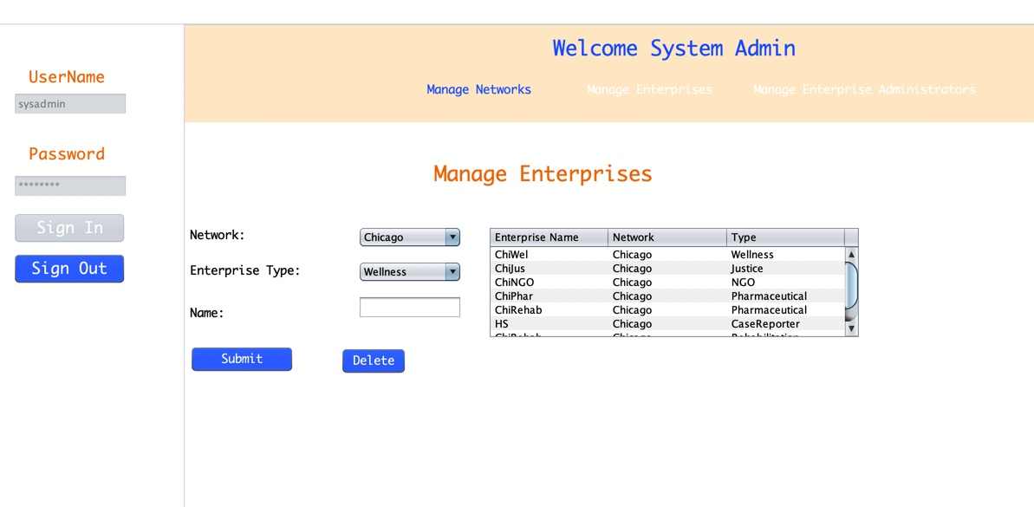
Screenshots

Slide 11
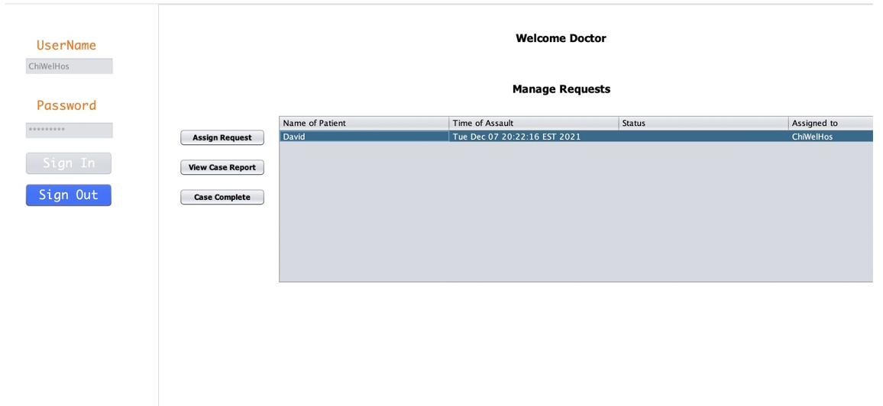
Screenshots

Slide 12
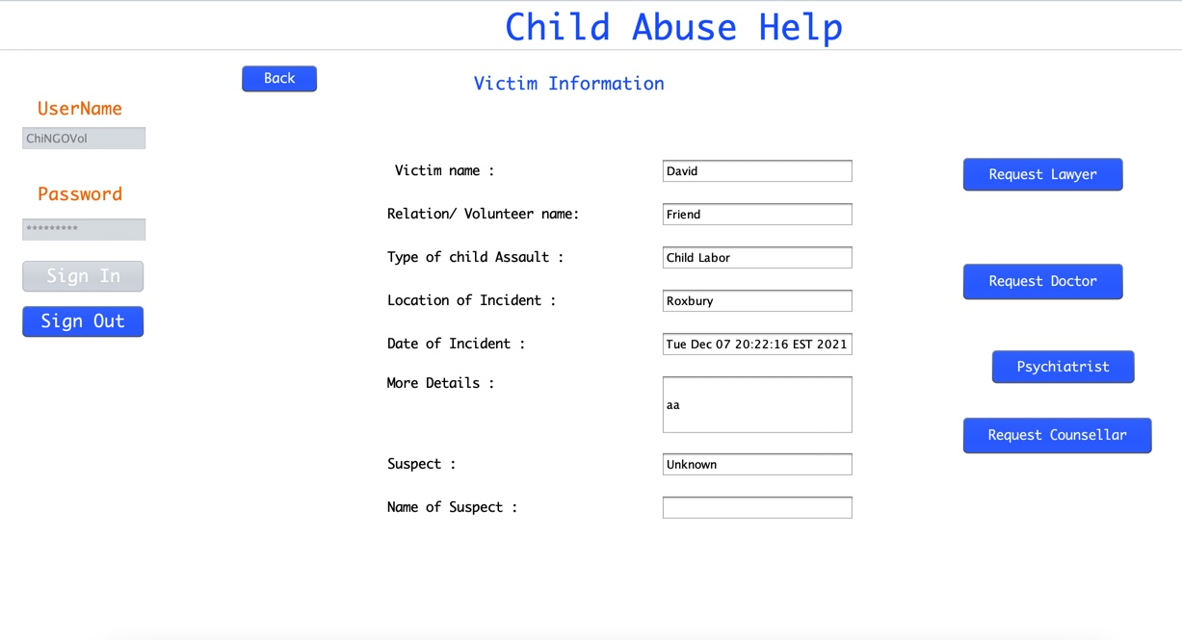
Screenshots

Slide 13
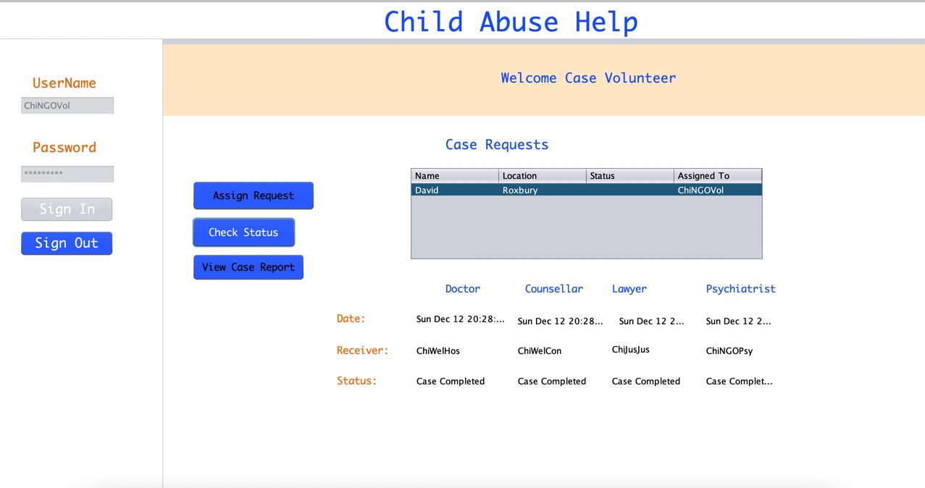
Screenshots

Slide 14
THANK YOU!

